Slide 1








ELECTRICITY
Class X Science, Chapter 12
A K CHOUBEY
SAINIK SCHOOL GOPALGANJ

Slide 2



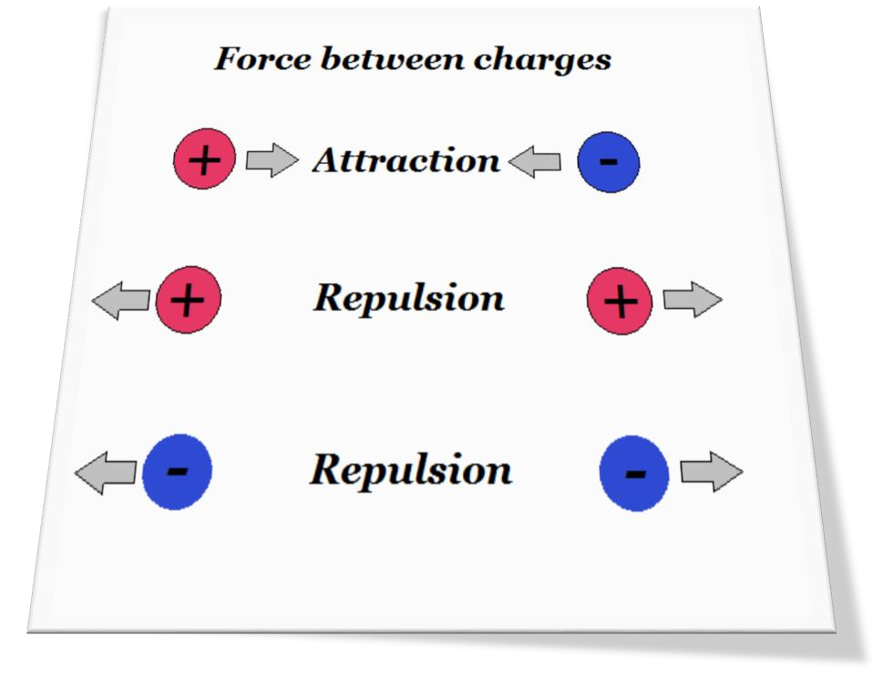

What is a Charge?
It is the fundamental property of matter because of which it experiences force.
Charges are of two type – positive charge
and negative charge.
Since charge of an electron (e = 1.6x10⁻¹⁹C) is very very small.
Therefore a more practical unit of charge is Coulomb (C) and one coulomb is equal to combined charge of 6.25x10¹⁸ electrons.

Slide 3
What is the basic difference between conductors and insulators?
Think before moving to the next slide

Slide 4
General response of Students
Conductors are substances which allow current to pass through them. For example Iron, Silver, Copper, Aluminum etc.
Insulators are substances which do not allow current to pass through them. For example Plastic, Wood, Glass, Rubber etc.
These responses are OK upto 8th Standard.
Since students have learnt atomic model or structure of an atom in 9th standard, this knowledge must be included to give them better understanding of concept of conductors and insulators.

Slide 5
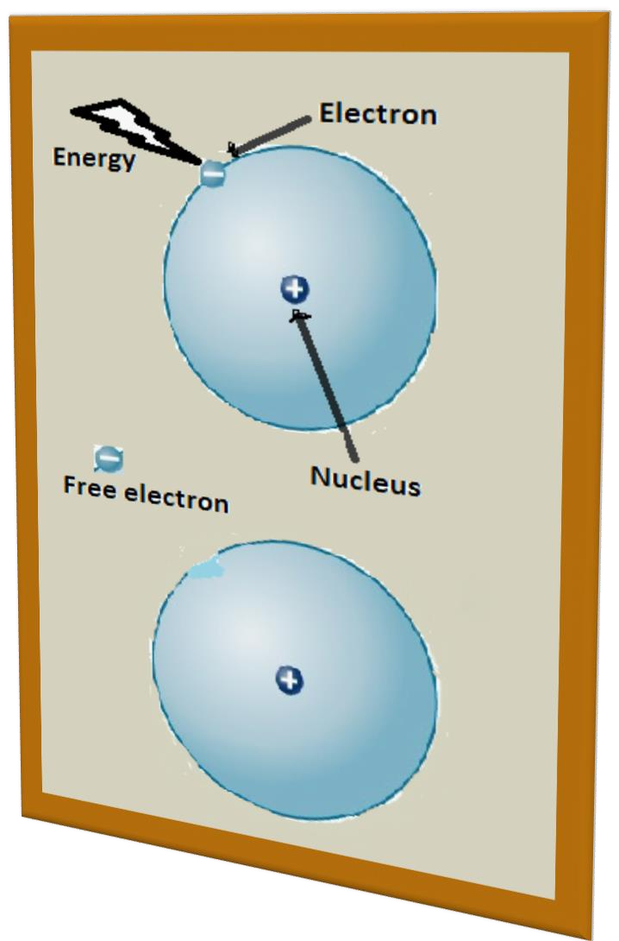
Concept of free electron
Matter is made up of atoms and each atom has a positively charged nucleus at the center with negatively charged electron revolve around it.
Negatively charge electron is bound to positively charge nucleus because of its charge.
If we provide energy to electron, it will not remain bound to the nucleus and just come out of an atom.
This type of electron is known as free electron because it is not bound to any particular nucleus and therefore free to move within the material.

Slide 6
Advance definition of Conductors and insulators
For some materials, energy required to free an electron is less and it can be acquired from the surrounding at room temperature.
These free electrons contribute to the electric current. Other electrons would remain bound to the nucleus and do not contribute to electric current.
The materials which can produce free electron at room temperature are known as conductors (because of less energy required to free an electron)
The materials which can not produce free electron at room temperature are known as insulators (because of large amount of energy required to free an electron)

Slide 7

Electric Current
Flow of free electrons through a conductor in a given direction is known as electric current.
SI unit of current is Ampere (A)
Electric current is measured as I = Q/t, where Q is charge in Coulombs (C) and t is time in seconds (s)

Slide 8

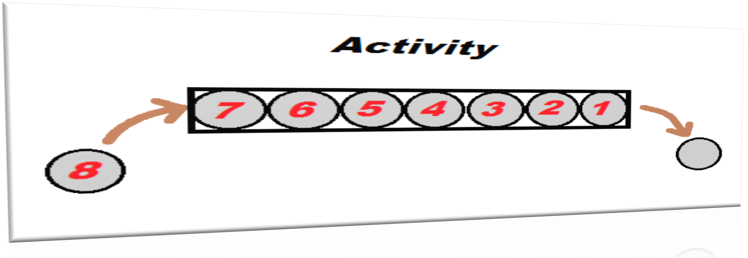
An activity for understanding flow of charge
In order to understand the flow of charge through a conductor, let us consider a hollow pipe containing 7 balls. If we try to push one more ball into the pipe from one end, a ball would come out from the other end of the pipe. It means that at any given time, there cannot be more than 7 balls in the pipe because there is no space for an extra ball.

Slide 9
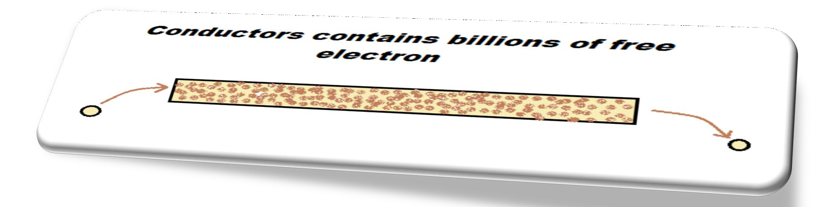
Mechanism of flow of charge
Going by the same logic that we have understood from the activity, a conductor may have billions or trillions of free electrons, but there is no space for an additional electron. It means that when we push an additional electron into the conductor from one end, an electron would come out from the other end. This happens instantly, it means that there is no time gap between pushing an electron from one end and jumping out of electron from the other end, either the length of the conductor is I meter or 1 kilometer.

Slide 10
Is there any charge on conductor, when current is passing through it?
There is a general misconception amongst the students, that during flow of current through the conductor, additional charge enters the conductor and because of this it will no longer remain neutral. As we have understand from the activity, there is no space for an additional electron in the conductor. Therefore the number of electrons in the conductor remains constant even during the passage of current through it. So there is no charge on the conductor, ever though the current is passing through it.

Slide 11
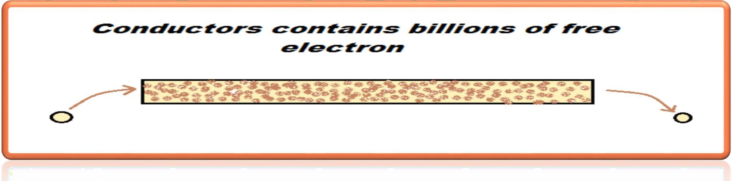
What is one Ampere?
In order to measure to the flow of electrons through a conductor, let us consider we are pushing 10 electrons into the conductor in one second. 10 electrons would come out from the other side of the conductor during the same period. So the flow of electron becomes 10 electrons per second. If we push 1 million electrons into the conductor in one second, the flow of current becomes 1 million electrons per second.
Going by the same logic, When one coulomb of charge (One Coulomb = 6.25x10¹⁸ electrons) passes through a conductor in one second, the flow of charge is said to be one ampere

Slide 12
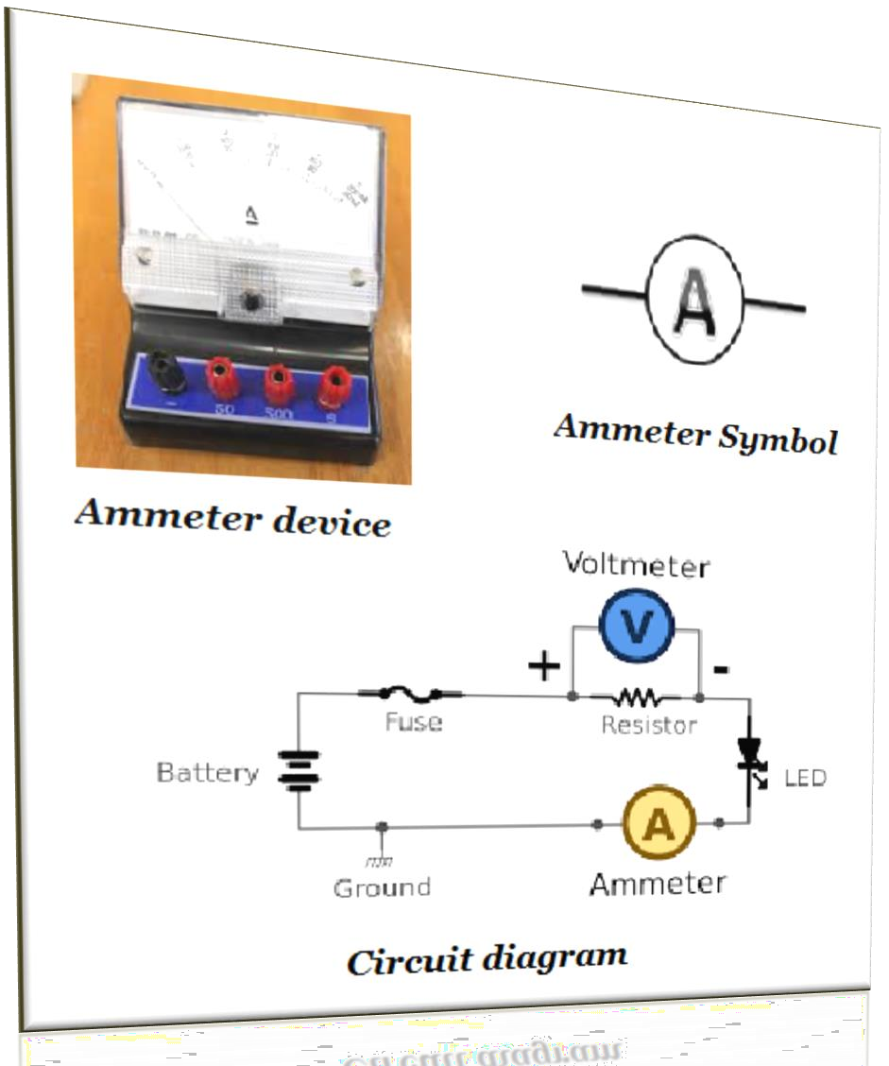
What is an ammeter?
It is a device used to measure the
current in the circuit.
It is always connected in series with the resistor.
It has very low internal resistance.
Positive terminal of Ammeter is connected to the positive side of the circuit and negative to the negative side.

Slide 13
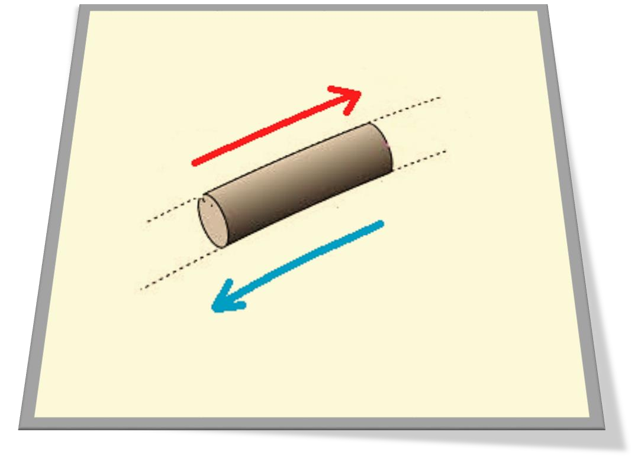

What is the direction of conventional current?
Since the free electrons are not bound to any particular nucleus, they can move freely within the conductor. But by convention, the flow of positive charge is considered to be the direction of current through the conductor. The direction of conventional current is opposite to the flow of free electrons through the conductor.

Slide 14
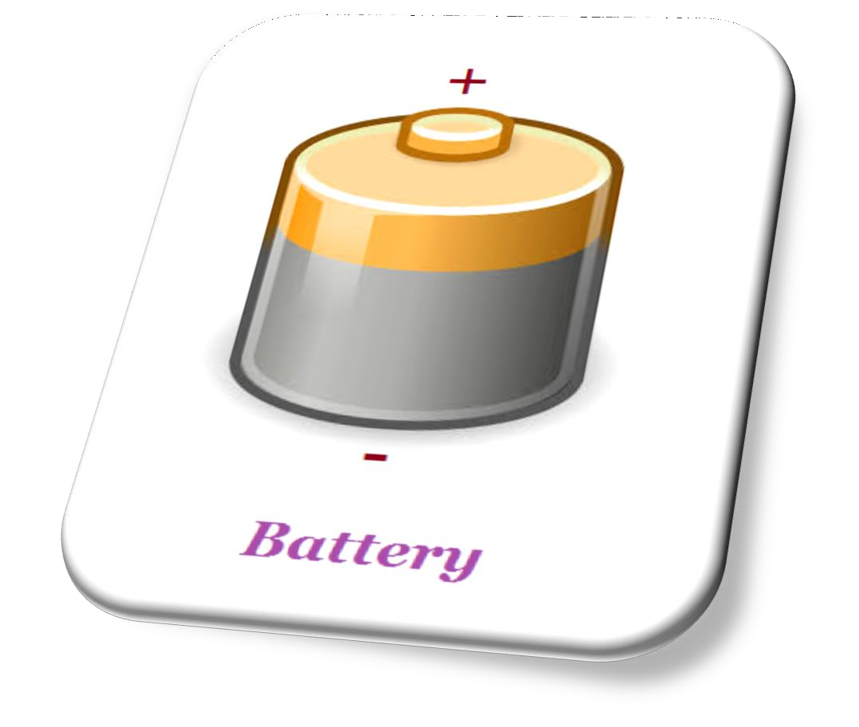
How to make the flow of charge happen through a conductor?
In order to pass the charge through a conductor, we have to push additional charge from one end and at the same time, withdraw same amount of charge from the other end.
This can be achieved with the help of device known as Battery or an Electric Cell.

Slide 15
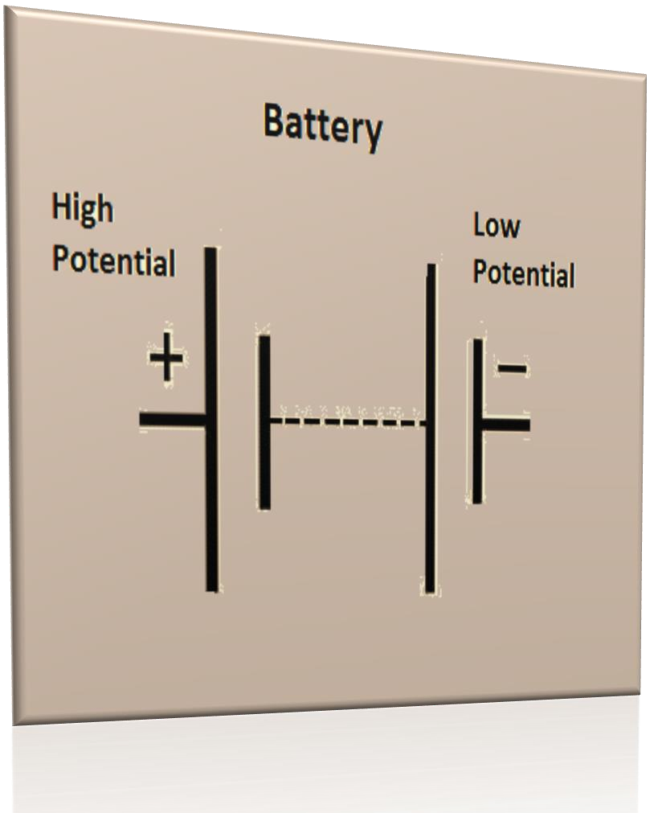
What is a Battery?
When two or more electric cells are connected in series, the system thus obtained is known as Battery.
Battery or electric cell has two terminals –
positive terminal and negative terminal.
Positive terminal is known as high potential because of its high potential energy, while negative terminal is known as low potential on account of its low energy.

Slide 16
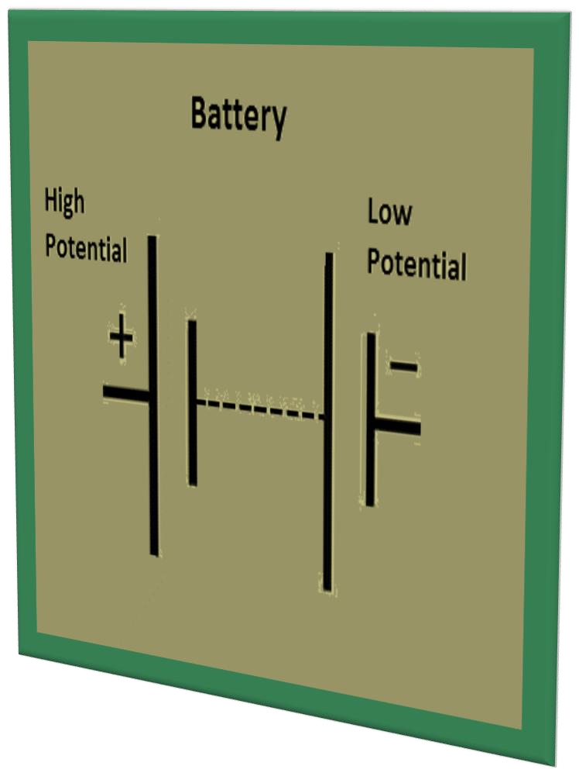
Electric Potential and Potential difference
The ability of a battery’s terminal to push (or pull) a unit charge into the conductor is known as Electric potential.
The difference of electric potential between the positive and negative terminals of a battery defines battery’s power to push charge into the conductor or more specifically it is known as potential difference.

Slide 17
What is voltage?
Potential difference is also known as Voltage.
Potential difference or voltage between any two point is defined as
the work done in moving a unit charge from one point to another.
It is given as V = W/Q, where W is work done in joules and Q is charge in Coulombs.
SI unit of voltage is Volts (V).
Voltage between two points is said to be one volt, when one joule of work is done in moving one coulomb of charge between these points.

Slide 18
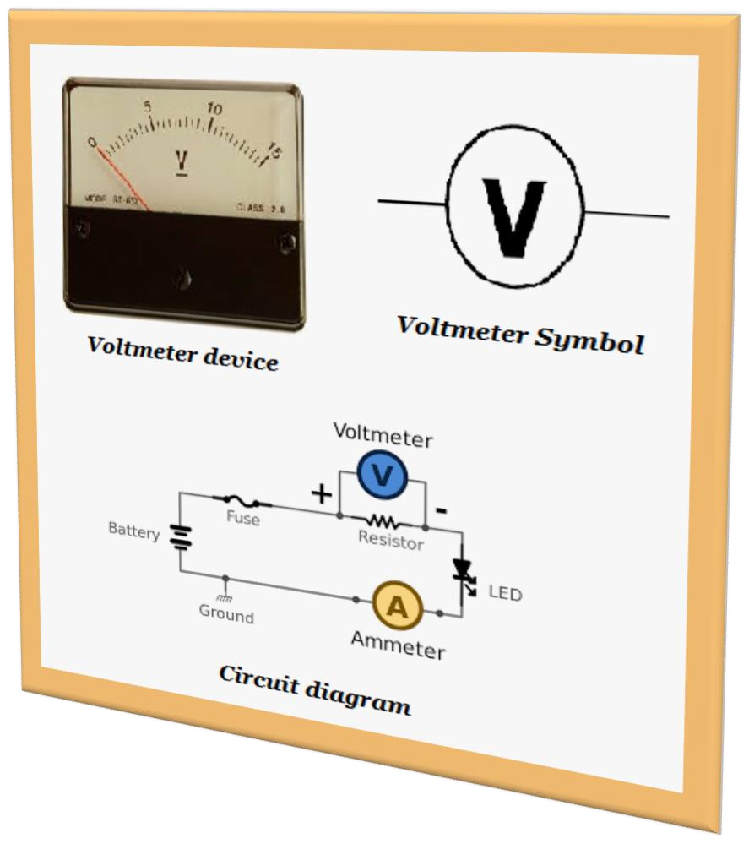
What is a Voltmeter?
It is a device used to measure the voltage across the resistance in the circuit.
It is always connected in parallel to the resistance.
It has very high internal resistance.
Positive terminal of the Voltmeter is connected to the positive side of the circuit and negative to the negative side.

Slide 19
Now putting everything together to understand how a bulb glows?
Think before moving to next slide

Slide 20
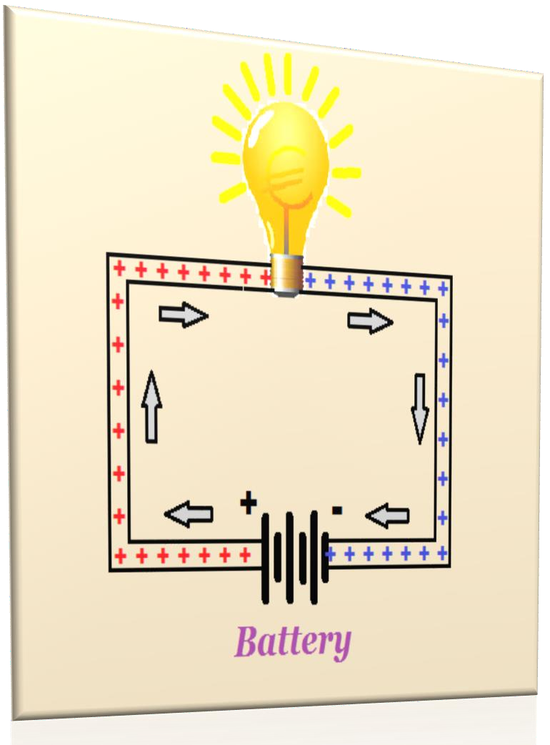
Glowing of a bulb
When the circuit is turned on, the positive terminal(rich in
positive charge) of the battery which is at high potential
pushes positive charge into the bulb through connecting wires.
At the same time, negative terminal(deficiency of positive
charge) of the battery which is at low potential pulls positive
charge from the bulb because of its polarity through connecting wire.
This act of pushing charge through the positive terminal and at
the same time, withdrawing the same amount of charge
through negative terminal is known as completing the circuit.
As the circuit becomes complete, the bulb starts glowing. The bulb will not glow, if the circuit is not complete.
It means that we cannot make a bulb glow by connecting it only to high potential or low potential terminals.
We have to create a potential difference by connecting the
conductor between high potential and low potential terminals of the battery, to pass the current through it.
Connecting wire
Connecting wire

Slide 21
Ohm’s law
We have to create a potential difference across a conductor by connecting it to battery, if current is to flow through the conductor.
The amount of current passing through the conductor depends upon the potential difference. This is known as Ohm’s law.
It states that the current through a conductor or wire is directly proportional to potential difference across the conductor provided the temperature remains constant. Mathematically V = IR, where V is potential difference, I current and R resistance of the conductor

Slide 22




Graphical Representation of Ohm’s law
Voltage (V)
The slope of the graph represents the resistance of the conductor
Current (I)

Slide 23
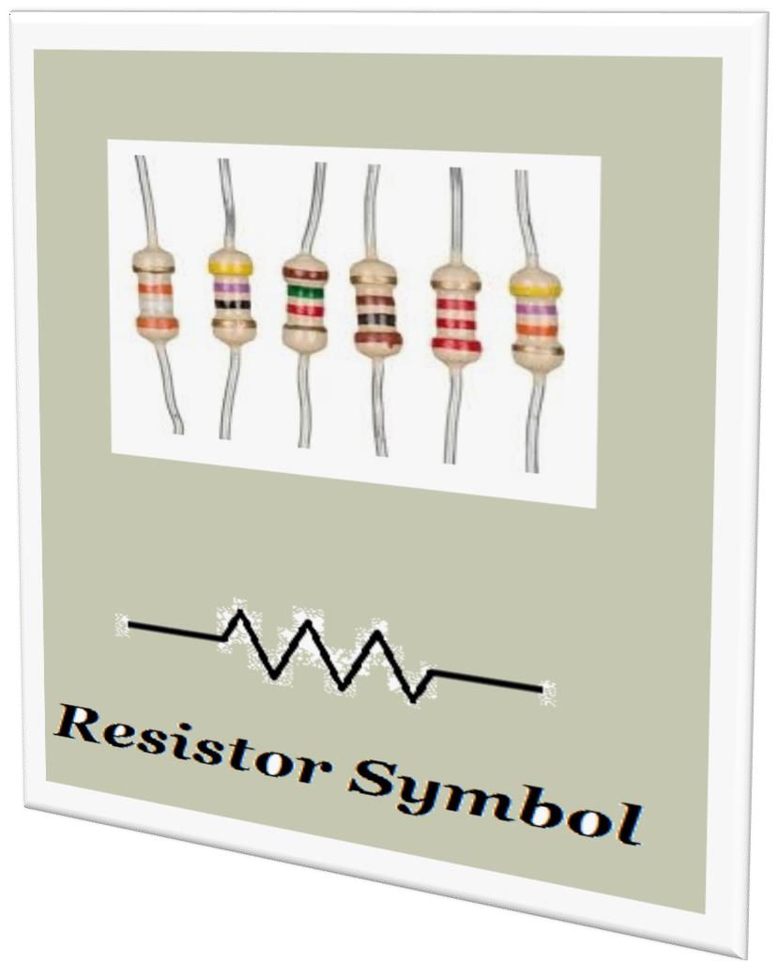
What is Resistance of a conductor?
It’s the fundamental property of substances because of which they obstruct the flow of charge through them.
SI unit of resistance is ohm (Ω).
Conductors have very low resistance while insulators have infinite resistance.
Materials with zero or negligible resistance are known as Superconductors.

Slide 24
Factors affecting the resistance of wire or conductor
Resistance (R) is directly proportional to the length of the wire (l). It means that longer wire has more resistance as compared to shorter wire.
Resistance (R) is inversely proportional to area of cross section of wire (A). It means that thin wires are more resistive than a thick wire.
Mathematically R = ρl/A, where ρ is the resistivity of the wire.

Slide 25
What is resistivity?
It is the resistance offered by a unit length and unit area of cross section of wire.
Its SI unit is Ωm.
Its value depends upon the nature of material. It means that the resistivity of copper is different from resistivity of aluminum.
Value of resistivity of few materials are given in the table.
Material | Resistivity (Ωm)
Silver | 1.60x10⁻⁸
Copper | 1.62x10⁻⁸
Aluminium | 2.63x10⁻⁸
Iron | 10.0x10⁻⁸
Nichrome | 100x10⁻⁶
Glass | 10¹⁰ – 10¹⁴
Rubber | 10¹³ – 10¹⁶

Slide 26
Combination of Resistors
Series and Parallel combinations.

Slide 27

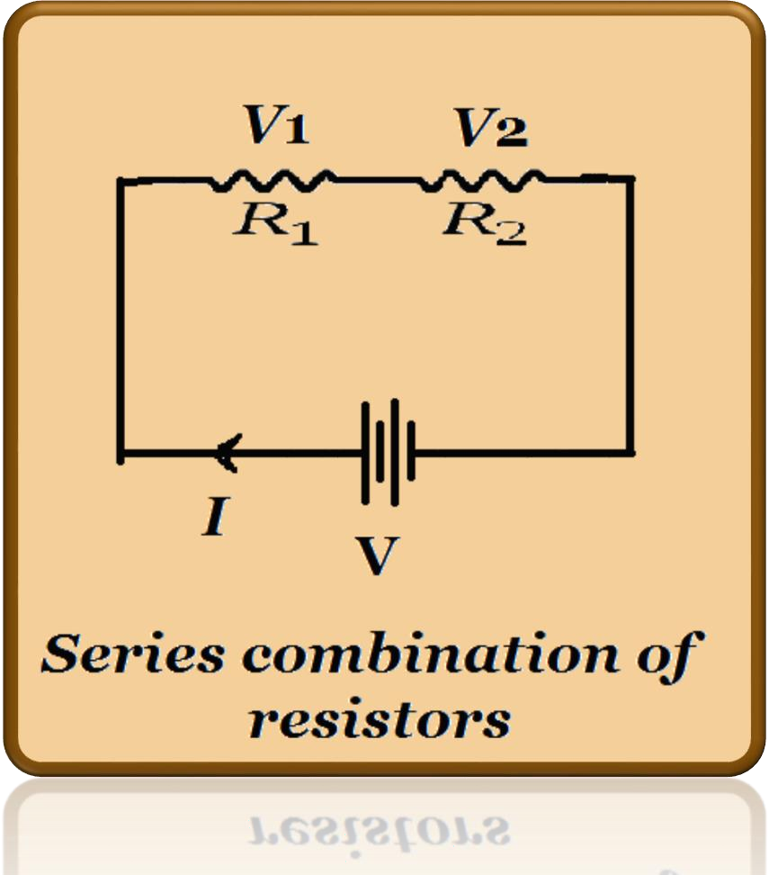
Series combination of resistors
Current in series combination remains
constant through all the resistors.
Voltage is divided amongst different resistors in series combination, V₁ across R₁ and V₂ across R₂.
Voltage across a resistor depends upon the value of its resistance.
Equivalent resistance of two given resistors in series is calculated as
R = R₁ + R₂

Slide 28
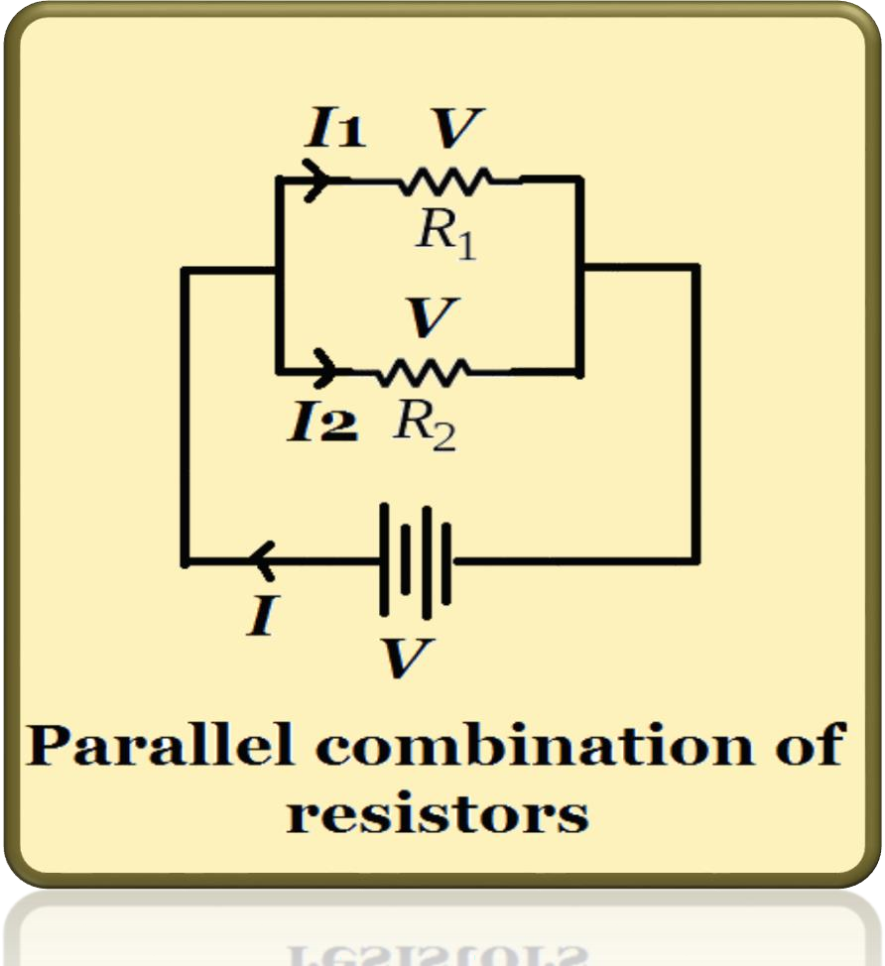
Parallel combination of resistors
Voltage remains constant across all the
resistors connected in parallel.
Current is divided amongst different branches of resistors, I₁ through R₁ and I₂ through R₂
Equivalent resistance of two resistors
connected in parallel is given as
1 ₌ 1 ₊ 1
R R₁ R₂

Slide 29
What is heating effect of current?
Heat produced by a conductor or resistance when current passes through it is known as Heating effect of current. Heat produced is measured in joules.
Voltage across a resistor is some time called as voltage drop because the resistor converts electrical energy into heat or some other form of energy.
Factors effecting the heat produced (H) is
  directly proportional to current through the conductor(I)
  directly proportional to resistance of the conductor(R)
  directly proportional to time for which current passes through the conductor(t)
Mathematically H = I²Rt

Slide 30
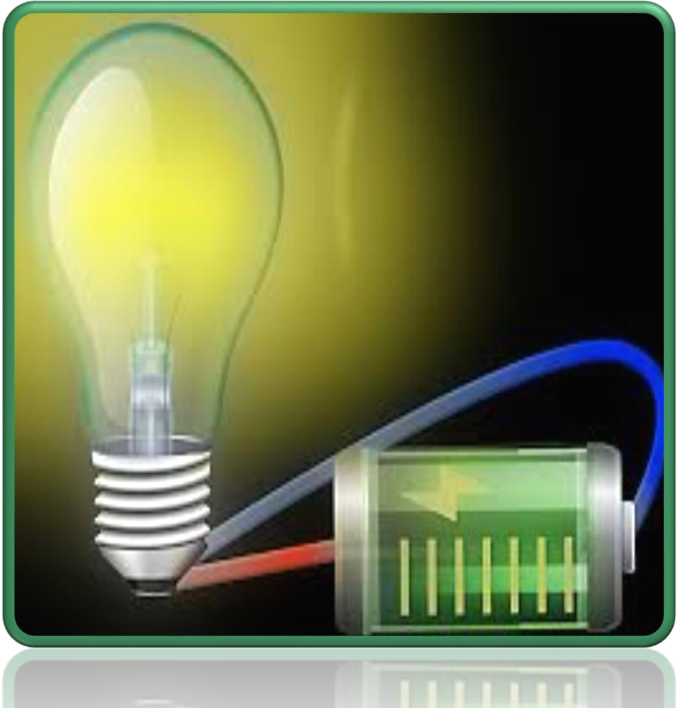
Electric Power
Heat produced by a device or circuit over a period of time is known as Electric Power.
SI unit of Power – Watts
Power of a device is said to be one watt if it consumes or produces one joule of energy in one second.
Commercial unit of energy – Unit or kWh.
1kWh or unit = 3.6x10⁶ joules
Electric power is given as
P= W/t, P = I²R, P = V²/R, P = VI

Slide 31
The End

Slide 32
https://diksha.gov.in/cbse/play/collection/do_312796455245733888120257?contentType=TextBook&contentId=do_312795716139343872111746

